Slide 1
LITERARY TYPES & FORMS or LITERATURES OF THE WORLD
Course Outline
De La Salle – Lipa • College of Education Arts and Sciences • Languages and Literature Area

Slide 2
COURSE DESCRIPTION:
This course is designed to introduce the student to the different literary forms or genres, exemplified by select literary texts from various countries, written during different periods in world history.
De La Salle – Lipa • College of Education Arts and Sciences • Languages and Literature Area

Slide 3
GENERAL OBJECTIVE:
This course intends to familiarize the student with the different literary forms and to develop critical appreciation of literature.
De La Salle – Lipa • College of Education Arts and Sciences • Languages and Literature Area

Slide 4
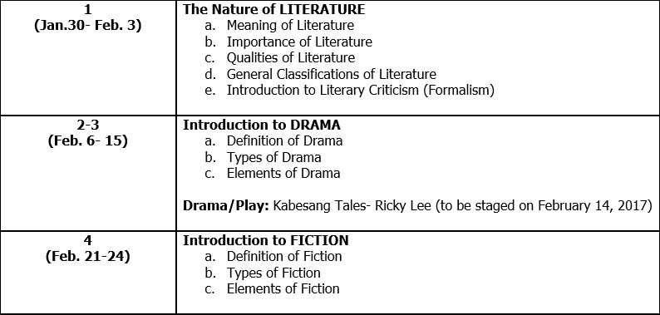
Contents:
De La Salle – Lipa • College of Education Arts and Sciences • Languages and Literature Area

Slide 5
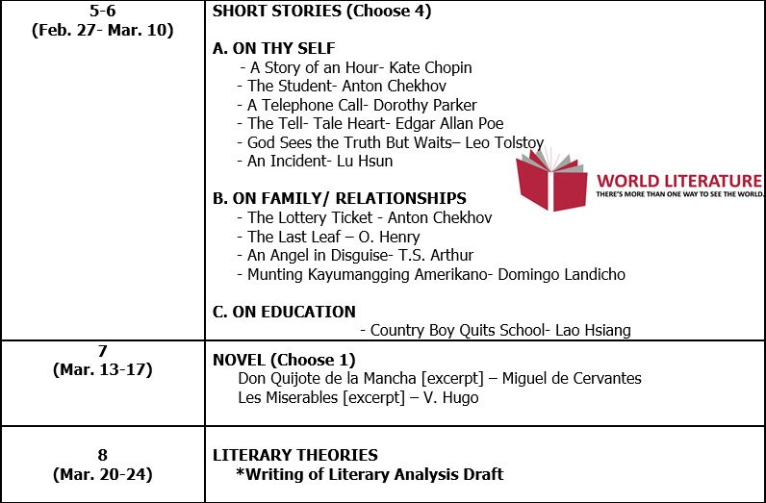
Contents:
De La Salle – Lipa • College of Education Arts and Sciences • Languages and Literature Area

Slide 6
Contents:
De La Salle – Lipa • College of Education Arts and Sciences • Languages and Literature Area

Slide 7
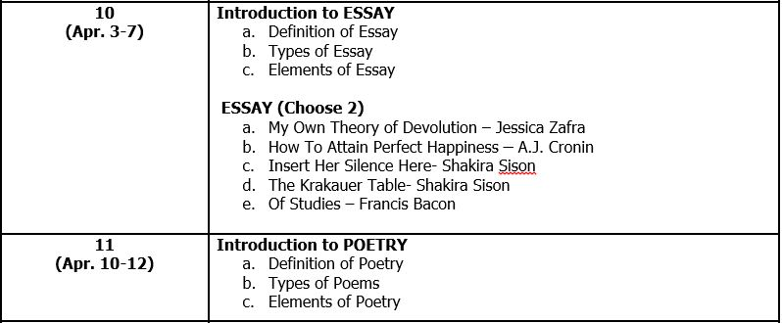
Contents:
De La Salle – Lipa • College of Education Arts and Sciences • Languages and Literature Area

Slide 8
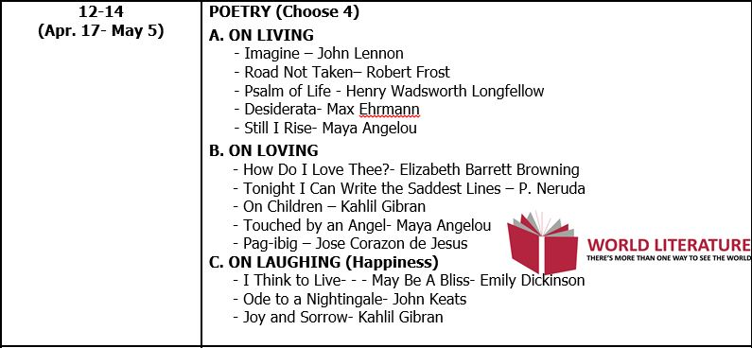
Contents:
De La Salle – Lipa • College of Education Arts and Sciences • Languages and Literature Area

Slide 9
Contents:
De La Salle – Lipa • College of Education Arts and Sciences • Languages and Literature Area

