Slide 1
ADVERTISING
Module 8
De La Salle – Lipa • College of Education Arts and Sciences • Multimedia Department

Slide 2
WHAT IS ADVERTISING?
Advertising is causing to know to remember, to do
Advertising is any form of paid non-personal presentation of ideas, goods or services for the purpose of inducting people to buy
Advertising is a paid form of non-personal presentation of ideas, goods or services by an identified sponsor
Advertising consists of all the activities involves in presenting to a group, a non-personal, oral or visual, openly sponsored message regarding disseminated through one or more media and is paid for by an identified sponsor
De La Salle – Lipa • College of Education Arts and Sciences • Multimedia Department

Slide 3
WHAT IS ADVERTISING?
A form of communication for marketing and used to encourage, persuade, or manipulate an audience (viewers-readers – listeners-a specific group) to continue or take some new action
Advertising means spreading of information about the characteristics of the product to the prospective customers with a view to sell the product or increase the sale volume
ad vertere means "to turn toward.“
De La Salle – Lipa • College of Education Arts and Sciences • Multimedia Department

Slide 4
Features of Advertising:
It is directed towards increasing the sales of business
Advertising is a paid form of publicity
It is non-personal. They are directed at a mass audience and nor at the individual as is in the case of personal selling.
Advertisement is identifiable with their sponsor of originator which is not always the case with publicity or propaganda.
De La Salle – Lipa • College of Education Arts and Sciences • Multimedia Department

Slide 5
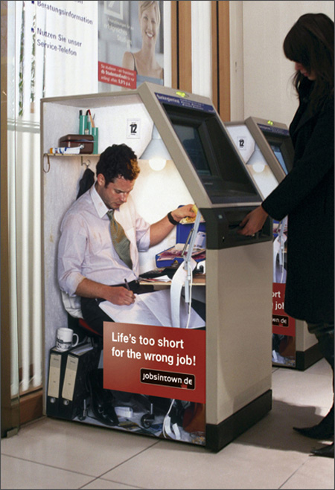
Objectives of Advertising:
1. Ground for New Product
New product needs introduction because potential customers have never used such product earlier and the advertisement prepare a ground for that new product.
De La Salle – Lipa • College of Education Arts and Sciences • Multimedia Department

Slide 6
2. Creation of Demand
- The main objective of the advertisement is to create a favorable climate for maintaining of improving sales. Customers are to be reminded about the product and the brand. It may induce new customers to buy the product by informing them its qualities since it is possible that some of the customers may change their brands.
De La Salle – Lipa • College of Education Arts and Sciences • Multimedia Department

Slide 7
3. Facing the Competition
- Another important objective of the advertisement is to face to competition. Under competitive conditions, advertisement helps to build up brand image and brand loyalty and when customers have developed brand loyalty, becomes difficult for the middlemen to change it.
De La Salle – Lipa • College of Education Arts and Sciences • Multimedia Department

Slide 8
4. Creating or Enhancing Goodwill
- Large scale advertising is often undertaken with the objective of creating or enhancing the goodwill of the advertising company. This, in turn, increases the market receptiveness of the company's product and helps the salesmen to win customers easily.
De La Salle – Lipa • College of Education Arts and Sciences • Multimedia Department

Slide 9
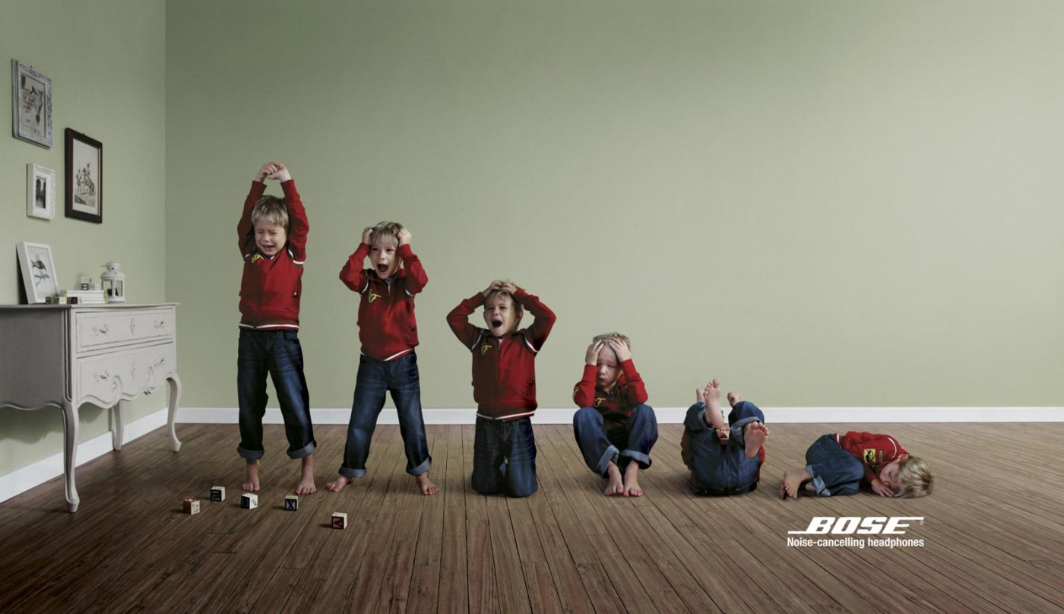
5. Informing the Changes to the Customers
- Whenever changes are made in the prices, channels of distribution or in the product by way of any improvement in quality, size, weight, brand, packing, etc., they must be informed to the public by the producer through advertisement.
De La Salle – Lipa • College of Education Arts and Sciences • Multimedia Department

Slide 10
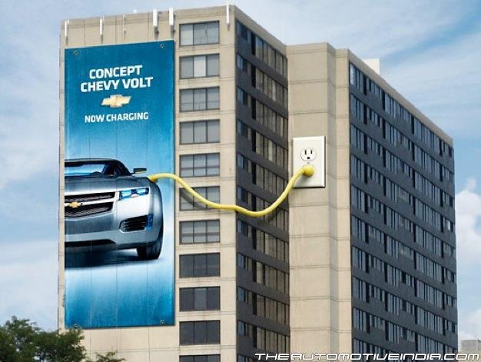
6.Neutralizing Competitor's Advertising
- Advertising is unavoidable to complete with or neutralize competitor's advertising. When competitors are adopting intensive advertising as their promotional strategy, it is reasonable to follow similar practices to neutralize their effects. In such cases, it is essential for the manufacturer to create a different image of his product.
De La Salle – Lipa • College of Education Arts and Sciences • Multimedia Department

Slide 11
7. Barring New Entrants
-From the advertiser's point of view, a strongly built image through long advertising helps to keep new entrants away. The advertisement builds up a certain monopoly are for the product in which new entrants find it difficult to enter.
-In short, advertising aims at benefiting the producer, educating the consumer and supplementing the salesmen. Above all it is a link between the producer and the consumer.
De La Salle – Lipa • College of Education Arts and Sciences • Multimedia Department

Slide 12
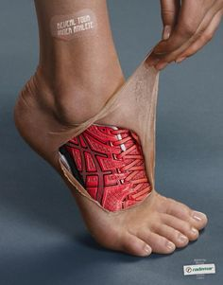
Benefits of Advertising:
1. Brand Awareness & Exposure
An organization’s main objective should be to keep its brand on the mind of its target audience. Frequent advertising builds awareness, awareness builds familiarity, and familiarity builds trust. If a brand stops advertising, prospects and current customers may think it is troubled or out of business. Advertising is even more important for brands undergoing major change, such as a re-branding or establishing their independence from a parent corporation.
2. Thought Leadership
A brand must become a thought leader within its industry. This can provide brand differentiation and build awareness. Advertising should be combined with PR, social media, seminars/webinars, speaking engagements, education and white papers—creating an integrated marketing communications plan focused on making a brand the recognized expert in its industry.
De La Salle – Lipa • College of Education Arts and Sciences • Multimedia Department

Slide 13
Benefits of Advertising:
3. Boost Sales With Lead Generation
A well-executed, targeted campaign can trigger quick sales. There are numerous methods for adding a measurable call-to-action to any advertisement.
4. Buying Power
Media outlets need money and advertising is a primary revenue stream. With less advertisers in certain industries there is more room for negotiation and opportunities for better or unique placement.
De La Salle – Lipa • College of Education Arts and Sciences • Multimedia Department

Slide 14
Benefits of Advertising:
5. Historical Precedence
Over the years, numerous studies and case histories have been developed to prove that companies should maintain advertising during a recession. History tells us that the best results (increased sales, attendance, funding, etc.) among competing companies through tough economic periods were produced by the organizations that advertised the most.
6. Influence
Today’s advertising influences tomorrow’s buyers. Advertising turns wants into needs.
De La Salle – Lipa • College of Education Arts and Sciences • Multimedia Department

Slide 15
Benefits of Advertising:
7. Competitive edge
Frequent advertising can help a brand establish forefront awareness and beat its competition.
8. Consistency
Advertising helps establish even sales throughout the year. By advertising on a regular basis and running special promotions, you can lessen the impact of slow periods.
De La Salle – Lipa • College of Education Arts and Sciences • Multimedia Department

Slide 16
Benefits of Advertising:
9. Cut through the clutter
Unique, strategically-grounded advertising helps cut through the clutter by repeating a message to the target audience, increasing the odds that your message will be retained.
10. Reach
Advertising can reach geographically dispersed target audiences at a low cost per exposure.
De La Salle – Lipa • College of Education Arts and Sciences • Multimedia Department

